Slide 1

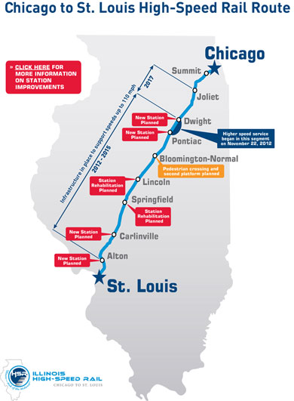
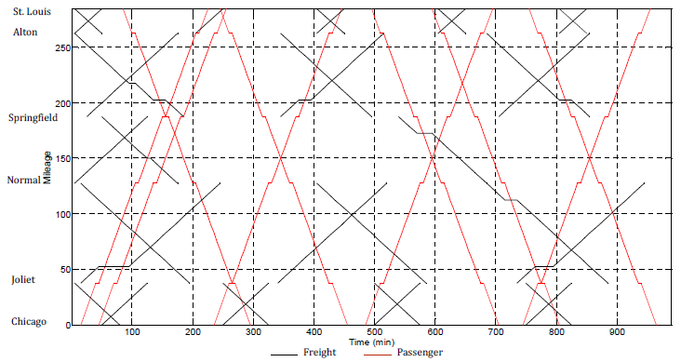


William W. Hay Railroad Engineering Seminar
“Integrated Modeling of High Performance Passenger and Freight Train Operation Planning on Shared Use Rail Corridors”
Dr. Bo Zou
Assistant Professor
University of Illinois at Chicago
^{Date: Friday, October} ^{17, 2014}
^{Time: Seminar Begins 12:15}
Location: Newmark Lab, Yeh Center, Room 2311
University of Illinois at Urbana-Champaign
^{Sponsored by}

Slide 2
Integrated Modeling of High Performance Passenger and Freight Train Operation Planning on Shared Use Rail Corridors: A Focus on the US Context
Ahmadreza Talebian, Bo Zou
University of Illinois at Chicago
Presentation at UIUC
Oct 17, 2014
Notes:
Before the train departed from Chicago Union Station, the conductor said the train will be delayed. Amtrak does not own the track line, although Amtrak is supposed to have the scheduling priority.
We are at the mercy of the freight railroads, although we are supposed to have scheduling priority.

Slide 3
Outline
Background
Literature review
Hypergraphs
  The train schedule model
    Modeling approach
    Passenger train scheduling
    Freight train scheduling
  Solution approach
  Numerical analysis
  Summary and conclusion

Slide 4
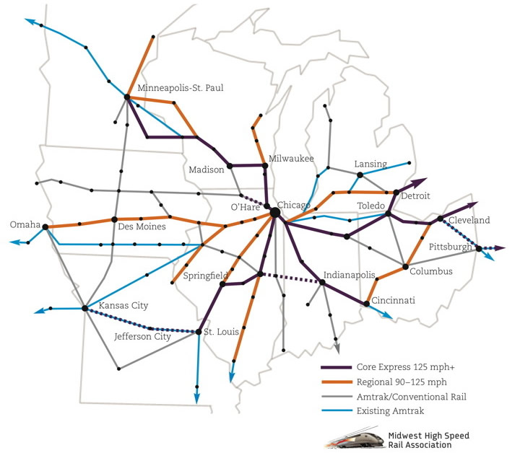
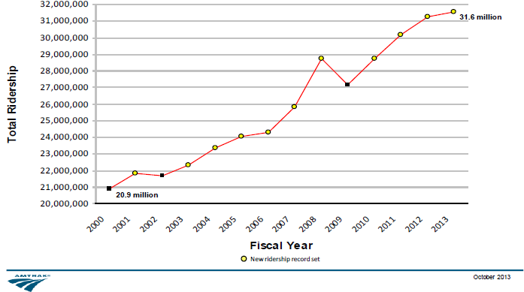
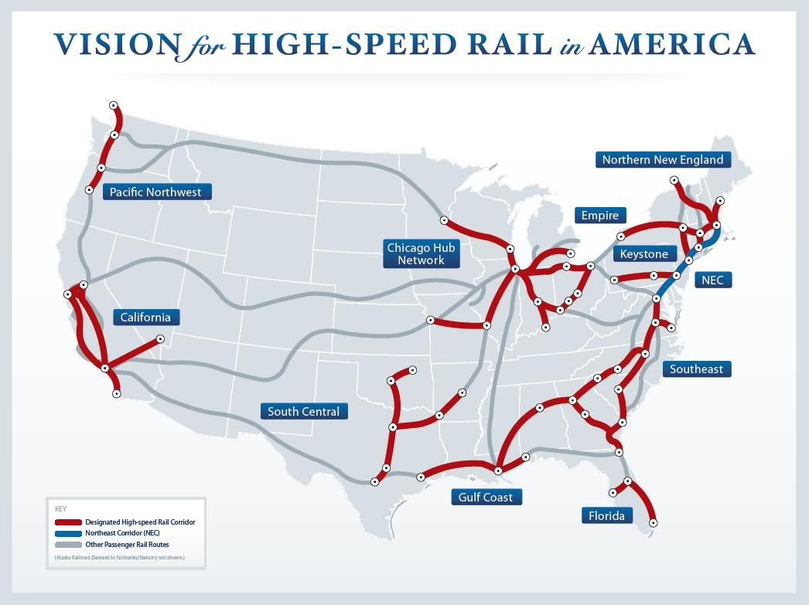
Background
Passenger rail resurgence in the US
High performance rail systems (HSR and HrSR services)
Midwest: existing single track lines are being upgraded to accommodate trains running at a maximum speed of 110 mph

Slide 5
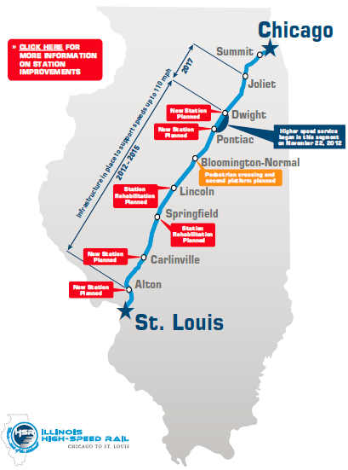
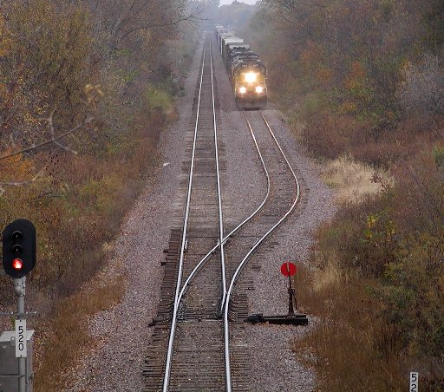
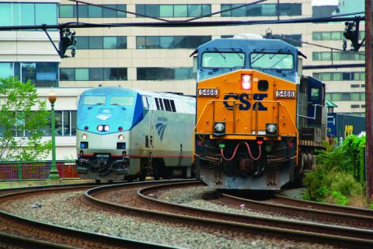
Background
Illinois HSR: Chicago-St. Louis (current phase)
  Single track (with sidings)
  Shared passenger and freight use
  High speed passenger trains operating at 110 mph
Source: IDOT (2014)

Slide 6
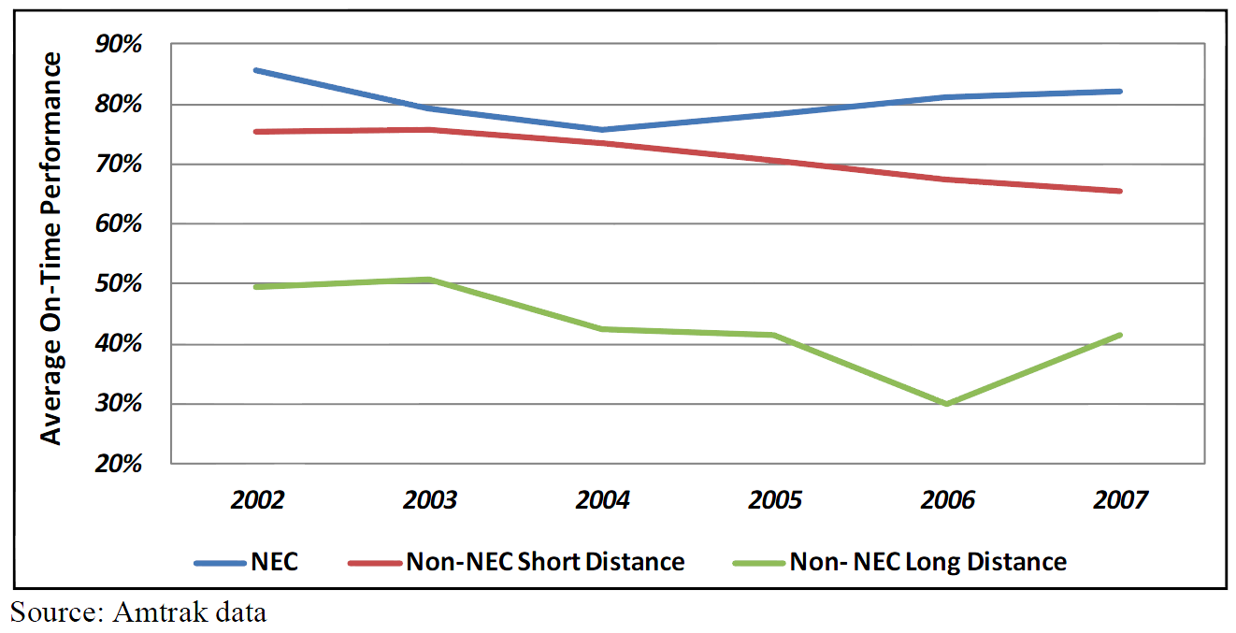
Background
Non-trivial delays to passenger and freight trains
Interactions between passenger and freight operations
This research develops a strategic level schedule planning model for mixed train operations on single-track, shared use passenger and freight corridors

Slide 7
Literature review
Three approaches in train scheduling: analytical, simulation, and optimization
Authors | Objective | Modeling priority | Discrete time | Model structure
Brännlund et al., 1998 | Min schedule deviation | Y | Y | ILP
Oliveira and Smith, 2000 | Min schedule deviation | N | Y | ---
Caprara et al., 2002 | Min schedule deviation | N | Y | ILP
Caprara et al., 2006 | Min schedule deviation | Y | Y | ILP
Canca et al., 2011 | Min passengers’ waiting time | N | Y | INLP
Harrod, 2011 | Max total utility of trains | Y | Y | ILP
Liu and Kozan, 2011 | Min schedule makespan | Y | N | MILP
Discrete time modeling is dominant
Most of the studies use an “ideal timetable”

Slide 8
Literature review
Question: What is an “ideal schedule”?
Very limited efforts in obtaining ideal train schedules
Traveler schedule convenience: an important factor in designing passenger trains schedules
A measure of inconvenience of schedule to passengers: schedule delay

Slide 9
Literature review
Schedule delay:
The difference between one's desired departure time and the actual departure time

Slide 10
Literature review
Schedule delay is absent in passenger rail schedule planning
Binary integer programming is the prevailing choice for modeling
Commonly used segment (block) occupancy models are less capable to capture transitions
The emerging hypergraph based scheduling approach explicitly address transitional status

Slide 11
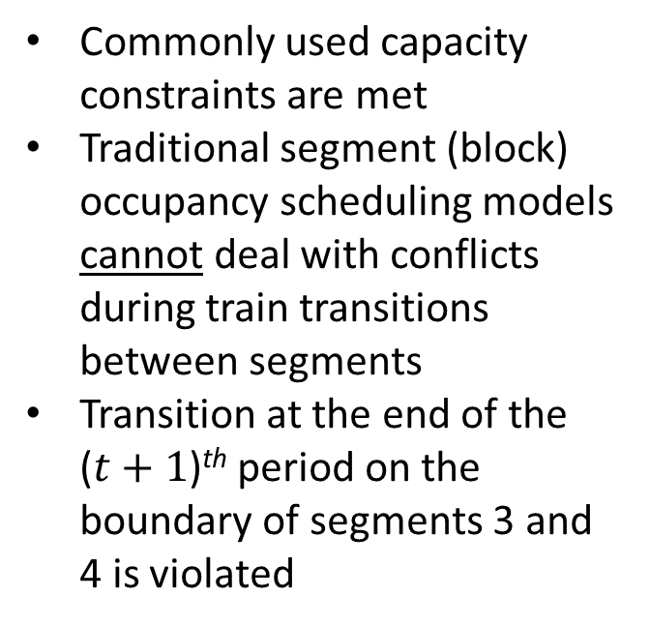
Hypergraphs
Deficiency of the traditional segment occupancy scheduling model
Commonly used capacity constraints are met
Traditional segment (block) occupancy scheduling models cannot deal with conflicts during train transitions between segments
Transition at the end of the ($t+1$)^{th} period on the boundary of segments 3 and 4 is violated
Each single segment is occupied by one train

Slide 12
Hypergraphs
Using Hypergraphs in train schedule modeling
Transition nodes
Each train movement is represented by a hyperarc
A chain of consecutive hyperarcs form a train path
Segment occupancy nodes
Segment occupancy nodes (1,t) and (2,t+1) and a transition node (1,t)
Notes:
Because of explicit enumeration of occupancy and transition nodes, capacity constraints and conflicts both within blocks and during transition can be explicitly considered

Slide 13
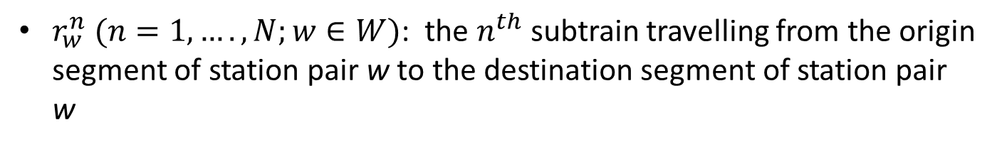
Hypergraphs
Definition: subtrain
Each sub-journey is conducted by a subtrain
$r_{w}^{n} (n=1,…. ,N;w∈W)$: the$n^{th}$ subtrain travelling from the origin segment of station pair w to the destination segment of station pair w

Slide 14
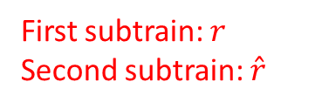
Hypergraphs
Linkage between subtrains
First subtrain: $r$
Second subtrain: $\hat{r}$
Linkage between two subtrains is established using a binary variable

Slide 15
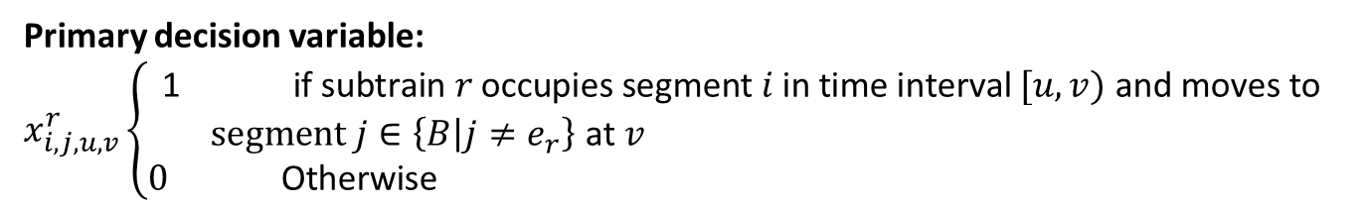
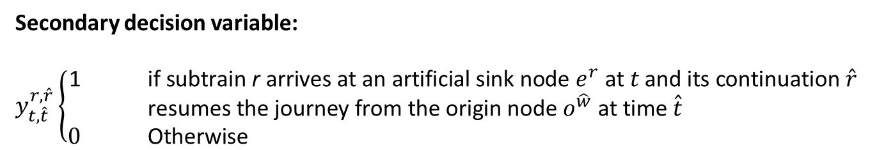
Hypergraphs
Decision variables
Primary decision variable:
$$x_{i, j, u,v}^{r}\left\{\begin{aligned}\text{1} \text{if} \text{subtrain} r \text{occupies} \text{segment} i \text{in} \text{time} \text{interval} [u,v) \text{and} \text{moves} \text{to} \\ segment j∈\left\{B | j≠e_{r}\right\} \text{at} v \\ 0 \text{Otherwise} \end{aligned}\right.$$
Secondary decision variable:
$y_{t,\hat{t}}^{r,\hat{r}}\left\{\begin{aligned}\text{1 }\text{if} \text{subtrain} \text{r} \text{arrives} \text{at} \text{an} \text{artificial} \text{sink} \text{node} e^{r} \text{at} t \text{and} \text{its} \text{continuation} \hat{r} \\ \text{resumes} \text{the} \text{journey} \text{from} \text{the} \text{origin} \text{node} o^{\hat{w}} \text{at} \text{time} \hat{t} \\ 0 \text{Otherwise} \end{aligned}\right.$

Slide 16
Modeling approach
We approach the train scheduling problem from a central planner’s perspective
By Public Law 110-432 (110 Congress, 2008), Amtrak trains have priority over all freight trains
A two-level sequential modeling approach
  Upper level: passenger train scheduling
  Lower level: freight train scheduling
Notes:
Hyperpath formulation enables sufficient and necessary conditions for addressing train path conflict.

Slide 17
Passenger train scheduling
Passenger-side costs
  Train operating expenses
  Passenger in-vehicle travel time cost
  Passenger schedule delay cost
We intend to design a schedule which permits two opposing passenger trains to pass without any full stop (flying meet).
Optimal train schedule:
Minimum passenger schedule delay
A function of passenger demand profile
Notes:
Hyperpath formulation enables sufficient and necessary conditions for addressing train path conflict.

Slide 18
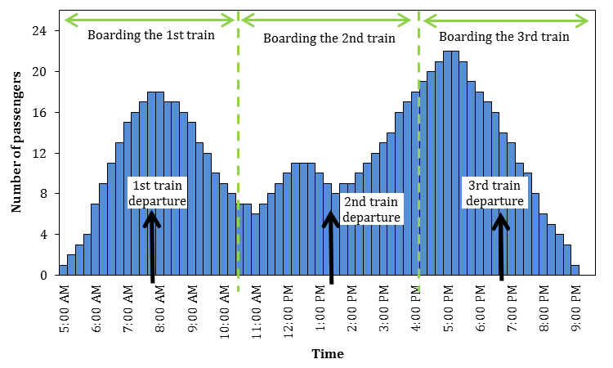
Passenger demand profile
  Each O-D pair has a passenger demand profile (Preferred Departure Time)
  Passengers are served by a predetermined number of trains

Slide 19
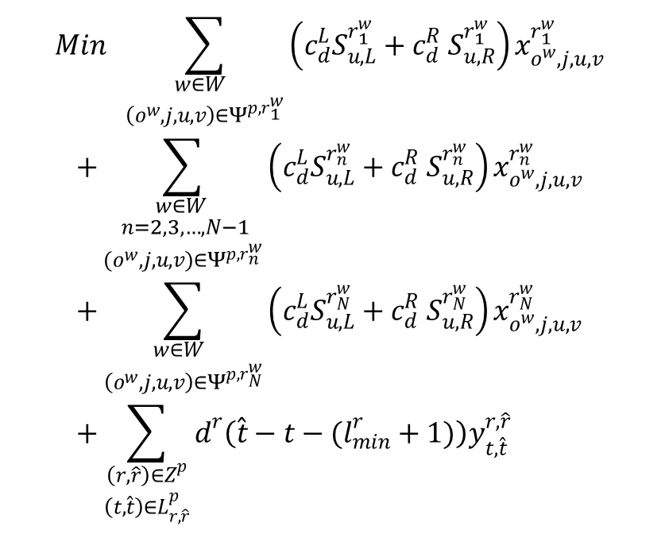
Passenger train scheduling
Objective function
$$Min \sum_{\begin{aligned}w∈W \\ \left(o^{w},j,u,v\right)∈Ψ^{p,r_{1}^{w}}\end{aligned}}{\left(c_{d}^{L}S_{u,L}^{r_{1}^{w}}+c_{d}^{R} S_{u,R}^{r_{1}^{w}}\right)x_{o^{w},j,u,v}^{r_{1}^{w}} }$$
$$+\sum_{\begin{aligned}w∈W \\ n=2,3,…,N−1 \\ (o^{w},j,u,v)∈Ψ^{p,r_{n}^{w}}\end{aligned}}{\left(c_{d}^{L}S_{u,L}^{r_{n}^{w}}+c_{d}^{R} S_{u,R}^{r_{n}^{w}}\right)x_{o^{w},j,u,v}^{r_{n}^{w}} }$$
$$+\sum_{\begin{aligned}w∈W \\ \left(o^{w},j,u,v\right)∈Ψ^{p,r_{N}^{w}}\end{aligned}}{\left(c_{d}^{L}S_{u,L}^{r_{N}^{w}}+c_{d}^{R} S_{u,R}^{r_{N}^{w}}\right)x_{o^{w},j,u,v}^{r_{N}^{w}} } \\ +\sum_{\begin{aligned}\left(r,\hat{r}\right)∈Z^{p} \\ \left(t,\hat{t}\right)∈L_{r,\hat{r}}^{p}\end{aligned}}{d^{r}\left(\hat{t}−t−(l_{min}^{r}+1)\right)y_{t,\hat{t}}^{r,\hat{r}}}$$
Schedule delay for passengers who take the first subtrain travelling between each station pair
Schedule delay for passengers who take an intermediate subtrain travelling between each station pair
Schedule delay for passengers who take the last subtrain travelling between each station pair
Penalty for staying longer than scheduled stop time at stations
Each term has to be calculated at preprocessing stage

Slide 20
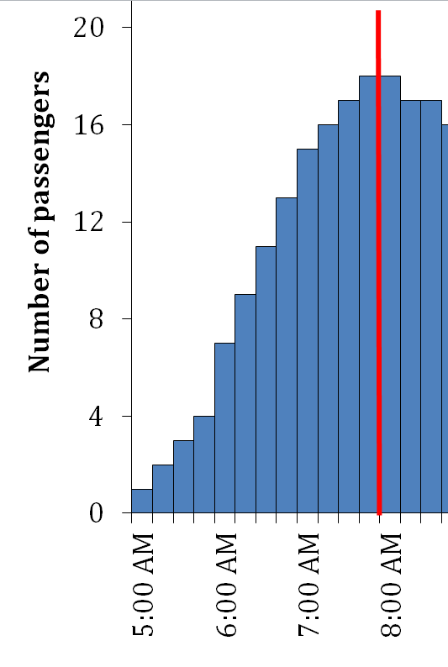
Passenger train scheduling
Objective function
Schedule delay calculation for the first subtrain

Slide 21
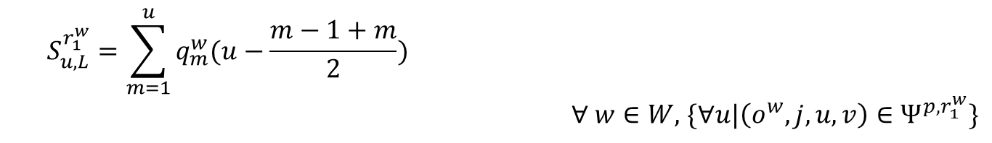
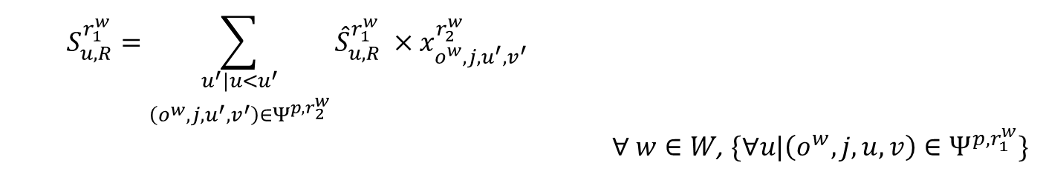
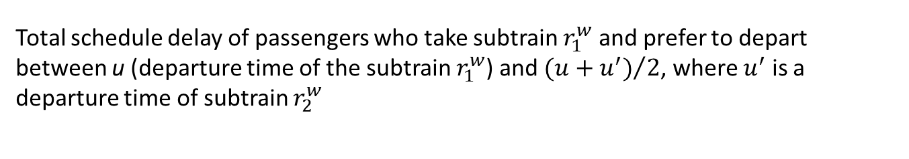
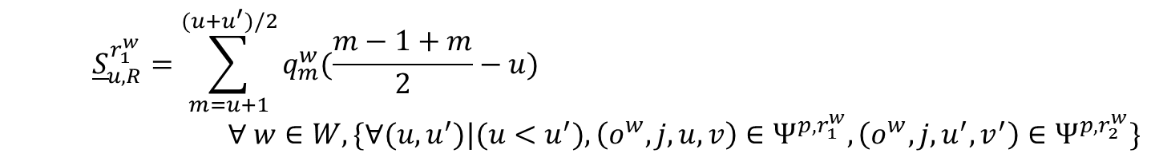
Passenger train scheduling
Objective function
Schedule delay calculation for the first subtrain
$$S_{u,L}^{r_{1}^{w}}=\sum_{m=1}^{u}{q_{m}^{w}(u−\frac{m−1+m}{2}})$$
$∀ w∈W,$ $\{∀u|\left(o^{w},j,u,v\right)∈Ψ^{p,r_{1}^{w}}\}$
$${\underline{S}}_{u,R}^{r_{1}^{w}}=\sum_{m=u+1}^{(u+u^{′})/2}{q_{m}^{w}(\frac{m−1+m}{2}}−u)$$
$$∀ w∈W, \{∀(u,u^{′})|(u<u^{′}), \left(o^{w},j,u,v\right)∈Ψ^{p,r_{1}^{w}},\left(o^{w},j,u^{′},v^{′}\right)∈Ψ^{p,r_{2}^{w}}\}$$
Total schedule delay of passengers who prefer to depart between t=1 and $u$ (departure time of subtrain $r_{1}^{w}$) and end up boarding subtrain $r_{1}^{w}$
Total schedule delay of passengers who prefer to depart after $u$ (departure time of subtrain $r_{1}^{w}$) and end up boarding subtrain $r_{1}^{w}$
Total schedule delay of passengers who take subtrain $r_{1}^{w}$ and prefer to depart between u (departure time of the subtrain $r_{1}^{w}$) and ${(u+u^{′})}/2$, where $u^{′}$ is a departure time of subtrain $r_{2}^{w}$
$$S_{u,R}^{r_{1}^{w}}=\sum_{\begin{aligned}u^{′}|u<u^{′} \\ \left(o^{w},j,u^{′},v^{′}\right)∈Ψ^{p,r_{2}^{w}}\end{aligned}}{{\hat{S}}_{u,R}^{r_{1}^{w}} ×x_{o^{w},j,u^{′},v^{′}}^{r_{2}^{w}}}$$
$∀ w∈W$, $\{∀u|\left(o^{w},j,u,v\right)∈Ψ^{p,r_{1}^{w}}\}$

Slide 22
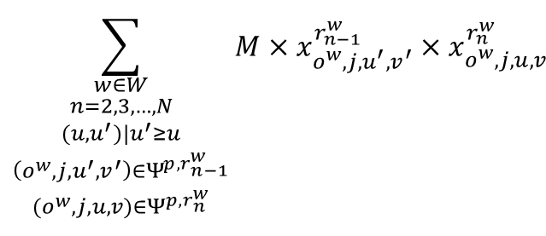
Passenger train scheduling
Objective function
Maintaining the order among subtrains
Maintaining the order among subtrains essentially ensures maintaining the order among physical trains
Penalize any combination of the starting arcs of two consecutive subtrains which violates the order of subtrains by a large number M
We add the following term to the objective function
$$\sum_{\begin{aligned}w∈W \\ n=2,3,…,N \\ (u,u^{′})|u^{′}≥u \\ \left(o^{w},j,u^{′},v^{′}\right)∈Ψ^{p,r_{n−1}^{w}} \\ (o^{w},j,u,v)∈Ψ^{p,r_{n}^{w}}\end{aligned}}{M×x_{o^{w},j,u^{′},v^{′}}^{r_{n−1}^{w}}×x_{o^{w},j,u,v}^{r_{n}^{w}}}$$

Slide 23
Constraints
Unique departure from origin
Unique sinking at the destination
Flow conservation
Linkage between trains
Binary variables
Segment capacity constraint
Segment transition constraint
Headway management

Slide 24
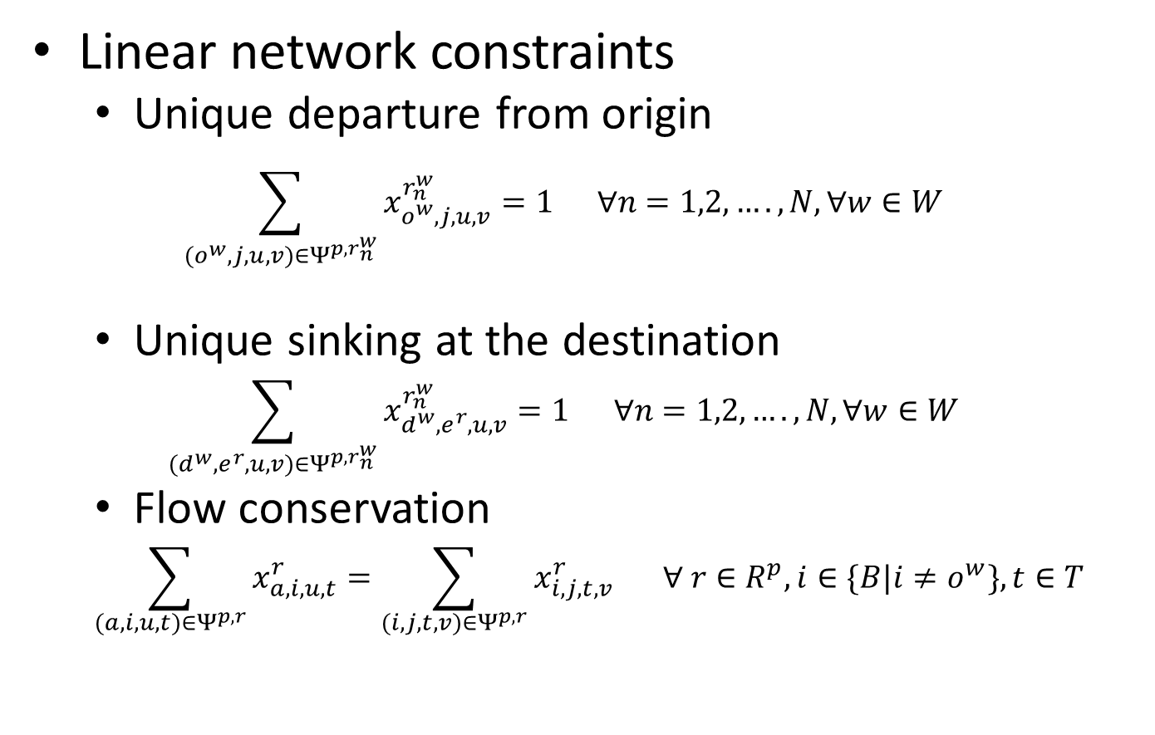
Constraints (1)
Linear network constraints
  Unique departure from origin
  $$\sum_{(o^{w},j,u,v)∈Ψ^{p,r_{n}^{w}}}{x_{o^{w},j,u,v}^{r_{n}^{w}}}=1 ∀n=1,2,….,N, ∀w∈W$$
  Unique sinking at the destination
  $$\sum_{(d^{w}, e^{r}, u,v)∈Ψ^{p,r_{n}^{w}}}{x_{d^{w}, e^{r}, u,v}^{r_{n}^{w}}}=1 ∀n=1,2,….,N, ∀w∈W$$
  Flow conservation
  $$\sum_{(a, i, u, t)∈Ψ^{p,r}}{x_{a, i, u, t}^{r}}=\sum_{(i, j, t, v)∈Ψ^{p,r}}{x_{i, j, t,v}^{r}} ∀ r∈R^{p}, i∈\{B|i≠o^{w}\}, t∈T$$

Slide 25
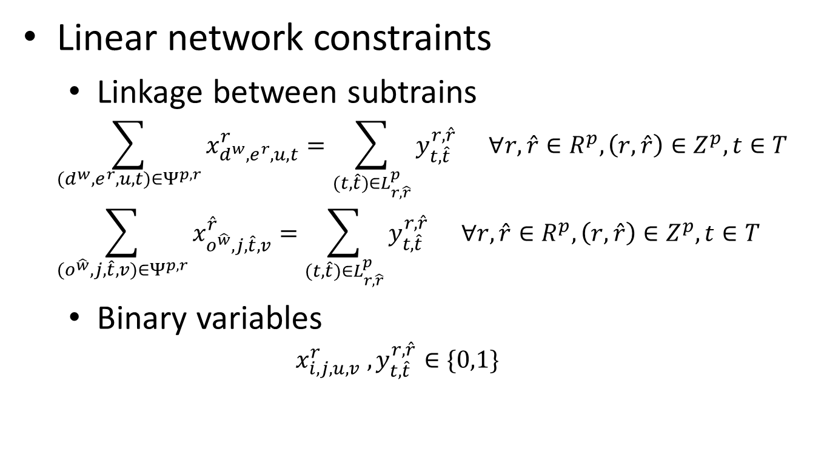
Constraints (2)
Linear network constraints
  Linkage between subtrains
  $$\sum_{(d^{w}, e^{r}, u,t)∈Ψ^{p,r}}{x_{d^{w}, e^{r},u, t}^{r}}=\sum_{(t,\hat{t})∈L_{r,\hat{r}}^{p}}{y_{t,\hat{t}}^{r,\hat{r}}} ∀r,\hat{r}∈R^{p}, \left(r,\hat{r}\right)∈Z^{p}, t∈T$$
  $$\sum_{(o^{\hat{w}}, j, \hat{t}, v)∈Ψ^{p,r}}{x_{o^{\hat{w}}, j, \hat{t}, v}^{\hat{r}}}=\sum_{(t,\hat{t})∈L_{r,\hat{r}}^{p}}{y_{t,\hat{t}}^{r,\hat{r}}} ∀r,\hat{r}∈R^{p},\left(r,\hat{r}\right)∈Z^{p}, t∈T$$
  Binary variables
  $$x_{i, j, u,v}^{r} , y_{t,\hat{t}}^{r,\hat{r}}∈\{0,1\}$$

Slide 26
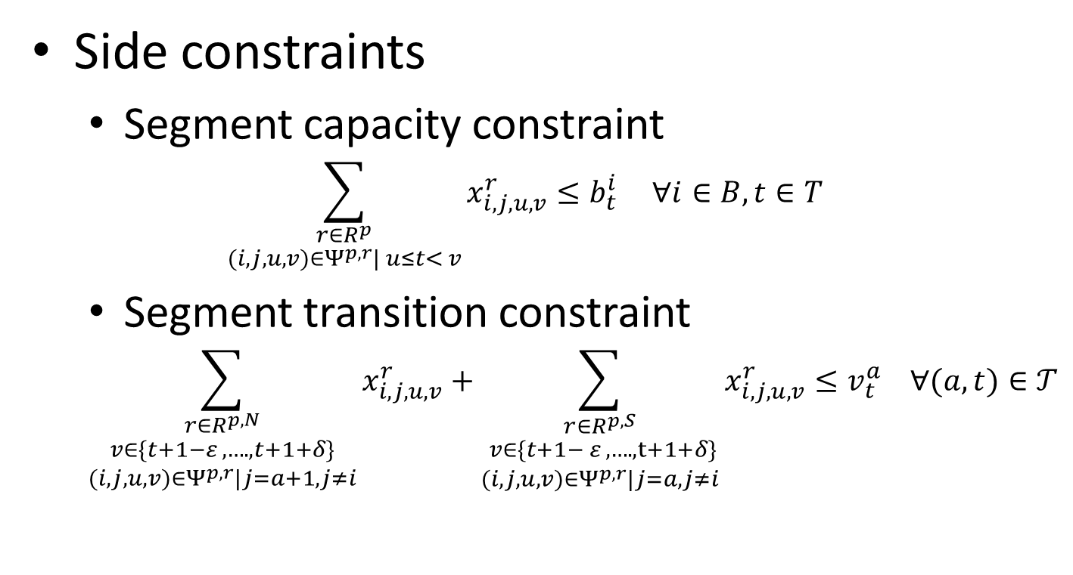
Constraints (3)
Side constraints
  Segment capacity constraint
  $$\sum_{\begin{aligned}r∈R^{p} \\ (i, j, u,v)∈Ψ^{p,r}| u≤t< v\end{aligned}}{x_{i, j, u,v}^{r}}≤b_{t}^{i} ∀i∈B, t∈T$$
  Segment transition constraint
  $$\sum_{\begin{aligned}r∈R^{p,N} \\ v∈\{t+1−ε , …., t+1+δ\} \\ (i, j, u,v)∈Ψ^{p,r}|j=a+1, j≠i\end{aligned}}{x_{i, j, u,v}^{r}}+\sum_{\begin{aligned}r∈R^{p,S} \\ v∈\{t+1− ε , …., t+1+δ\} \\ (i, j, u,v)∈Ψ^{p,r}|j=a, j≠i\end{aligned}}{x_{i, j, u,v}^{r}}≤v_{t}^{a} ∀(a,t)∈𝒯$$

Slide 27
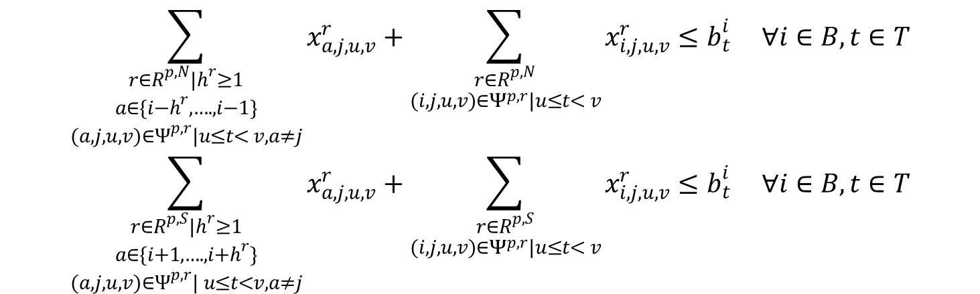
Constraints (4)
Side constraints
  Headway management
$$\sum_{\begin{aligned}r∈R^{p,N}|h^{r}≥1 \\ a∈\{i−h^{r}, …., i−1\} \\ (a, j,u,v)∈Ψ^{p,r}|u≤t< v, a≠j\end{aligned}}{x_{a, j, u,v}^{r}}+\sum_{\begin{aligned}r∈R^{p, N} \\ (i, j, u,v)∈Ψ^{p,r}|u≤t< v\end{aligned}}{x_{i, j, u,v}^{r}}≤b_{t}^{i} ∀i∈B, t∈T$$
$$\sum_{\begin{aligned}r∈R^{p, S}|h^{r}≥1 \\ a∈\{i+1, …., i+h^{r}\} \\ (a, j,u,v)∈Ψ^{p,r}| u≤t<v, a≠j\end{aligned}}{x_{a, j, u,v}^{r}}+\sum_{\begin{aligned}r∈R^{p,S} \\ (i, j, u,v)∈Ψ^{p,r}|u≤t< v\end{aligned}}{x_{i, j, u,v}^{r}}≤b_{t}^{i} ∀i∈B, t∈T$$

Slide 28
Freight train scheduling
Freight trains are inserted among the fixed schedule of passenger trains
A freight train is dispatched whenever the train receives enough load
Freight train scheduling is less precise and stringent
Freight side costs
  Foregone demand cost (loss of operating revenue)
  Departure delay cost
  En-route delay cost
Optimal train schedule:
Minimum total freight cost

Slide 29
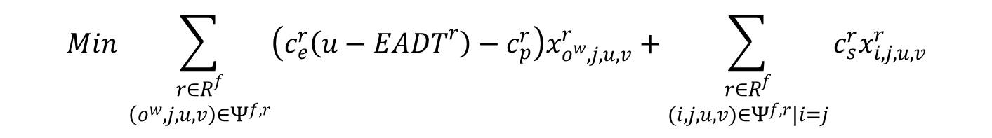
Freight train scheduling
Objective function
Departure delay cost
En-route delay cost
$$Min \sum_{\begin{aligned}r∈R^{f} \\ \left(o^{w}, j, u,v\right)∈Ψ^{f,r}\end{aligned}}{\left(c_{e}^{r}\left(u−{EADT}^{r}\right)−c_{p}^{r}\right)x_{o^{w}, j, u,v}^{r}}+\sum_{\begin{aligned}r∈R^{f} \\ (i, j, u,v)∈Ψ^{f,r}|i=j\end{aligned}}{c_{s}^{r}x_{i, j, u,v}^{r}}$$
Foregone demand cost

Slide 30
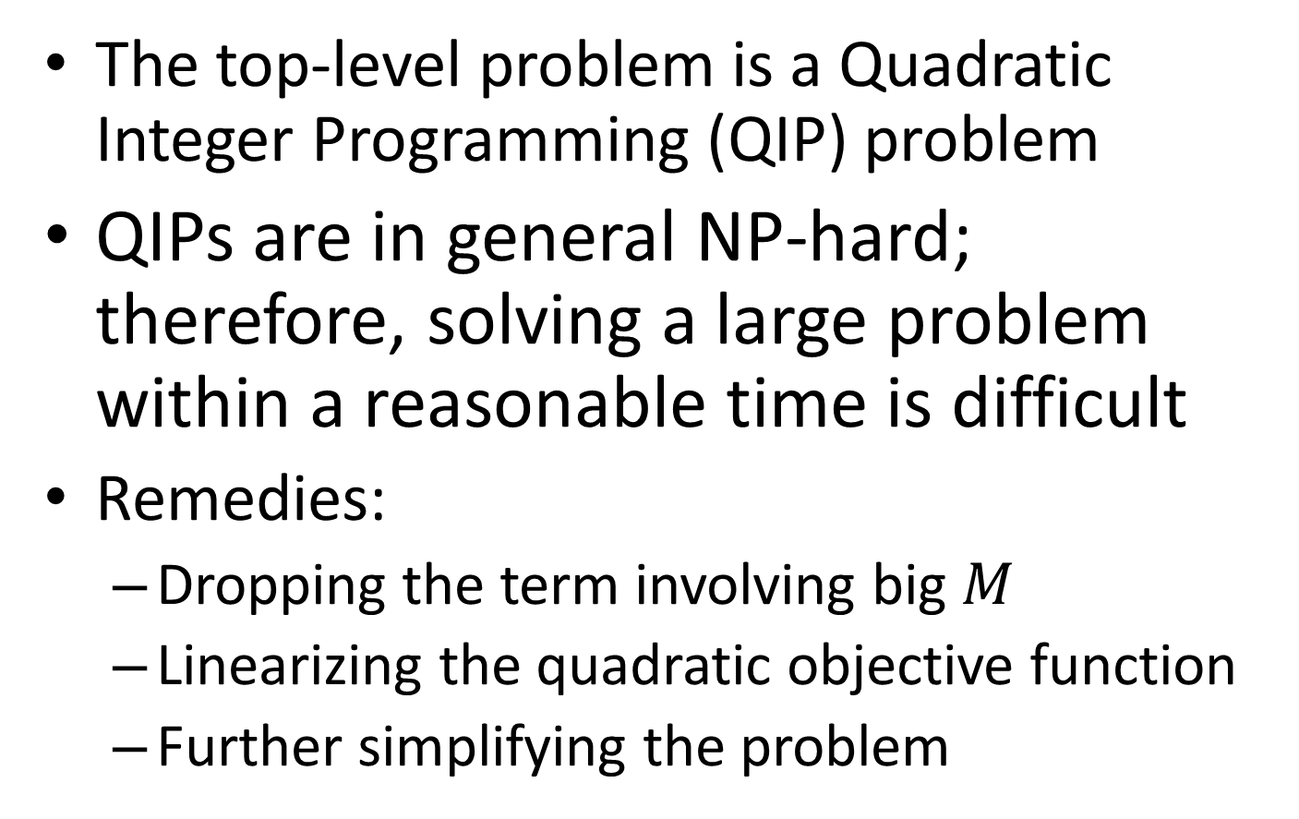
Solution approach
The top-level problem is a Quadratic Integer Programming (QIP) problem
QIPs are in general NP-hard; therefore, solving a large problem within a reasonable time is difficult
Remedies:
  Dropping the term involving big $M$
  Linearizing the quadratic objective function
  Further simplifying the problem
Notes:
Decision variable vector x is composed of $x_{i, j, u,v }^{r}$

Slide 31
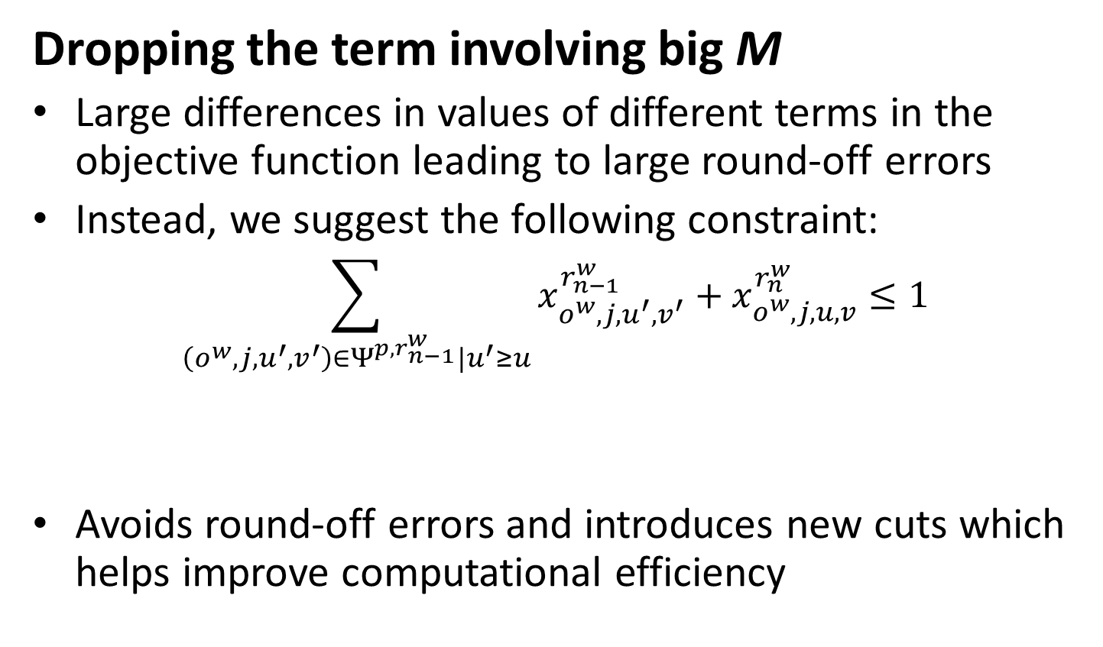
Solution approach
Dropping the term involving big M
Large differences in values of different terms in the objective function leading to large round-off errors
Instead, we suggest the following constraint:
$$\sum_{\left(o^{w},j,u^{′},v^{′}\right)∈Ψ^{p,r_{n−1}^{w}}|u^{′}≥u}{x_{o^{w},j,u^{′},v^{′}}^{r_{n−1}^{w}}+x_{o^{w},j,u,v}^{r_{n}^{w}}}≤1$$
Avoids round-off errors and introduces new cuts which helps improve computational efficiency
Starting arc of the later train plus all possible starting arcs of the immediate previous train must be equal to or less than one

Slide 32



Solution approach
Linearizing the quadratic objective function
Replace each quadratic term with a new binary variable
For each new variable, three inequality constraints need to be added
$$z_{u^{′},u}^{r_{n−1}^{w},r_{n}^{w}}=x_{o^{w},j,u^{′},v^{′}}^{r_{n−1}^{w}}.x_{o^{w},j,u,v}^{r_{n}^{w}}$$
$$∀w∈W, \left\{∀n=2,3,…,N\right\}, \{∀\left(u^{′},u\right)|u^{′}<u, (o^{w},j,u^{′},v^{′})∈Ψ^{p,r_{n−1}^{w}} ,(o^{w},j,u,v)∈Ψ^{p,r_{n}^{w}}\}$$
$$z_{u^{′},u}^{r_{n−1}^{w},r_{n}^{w}}≤x_{o^{w},j,u^{′},v^{′}}^{r_{n−1}^{w}}$$
z is less than either of the associated x variable values; z equals one only when both x’s are equal to one
$$z_{u^{′},u}^{r_{n−1}^{w},r_{n}^{w}}≤x_{o^{w},j,u,v}^{r_{n}^{w}}$$
$$x_{o^{w},j,u^{′},v^{′}}^{r_{n−1}^{w}}+x_{o^{w},j,u,v}^{r_{n}^{w}}≤1+z_{u^{′},u}^{r_{n−1}^{w},r_{n}^{w}}$$

Slide 33
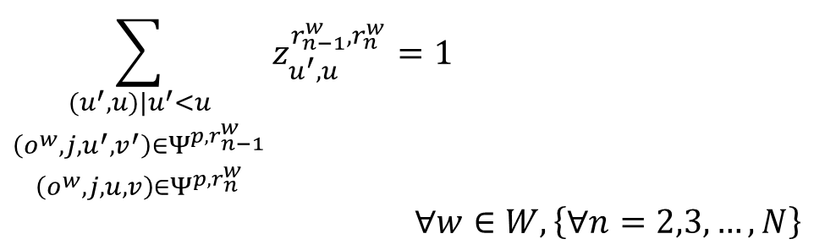
Solution approach
Further simplifying the problem
Replace the last inequality constraint in the previous slide by
The new constraint set represents the same characteristics with much fewer constraints
$$\sum_{\begin{aligned}(u^{′},u)|u^{′}<u \\ \left(o^{w},j,u^{′},v^{′}\right)∈Ψ^{p,r_{n−1}^{w}} \\ \left(o^{w},j,u,v\right)∈Ψ^{p,r_{n}^{w}}\end{aligned}}{z_{u^{′},u}^{r_{n−1}^{w},r_{n}^{w}}}=1$$
$$∀w∈W, \left\{∀n=2,3,…,N\right\}$$
Each subtrain has a unique departure. Therefore only one combination of starting arcs of two consecutive subtrains is equal to one.

Slide 34
Numerical analysis
A small problem
Impact of speed heterogeneity
A larger problem

Slide 35
Numerical analysis
A small problem
Set up:
  11 segments: 6 track segments and 5 sidings
  2 O-D pairs (one in each direction)
  Each track segment 18 miles long
  Sidings evenly distributed along the corridor, each 2 miles long
  Total corridor length: 120 miles

Slide 36
Numerical analysis
A small problem
Set up (cont’d)
  Operating speed
    Freight trains: 60 mph
    Passenger trains: 120 mph
  Consider daily service frequency of 1-6 trains
  Elastic passenger demand (elasticity: 0.4, based on Adler et al. (2010))

Slide 37
A small problem: results
Passenger schedule delay cost
Marginal schedule delay cost reduction diminishes with passenger train frequency

Slide 38
A small problem: results
Freight side costs
The total cost increases with passenger train frequency
Departure delay cost is relatively stable across all the six scenarios
En-route delay cost has an increasing trend
Foregone demand becomes the most important cost component when more than three passenger trains are scheduled

Slide 39
A small problem: results
Marginal costs
Net marginal benefit gains only occur when the number of passenger trains increases from one to two and from four to five (very slightly)

Slide 40
Impact of speed heterogeneity
Setup:
  Passenger train speed: 120 mph
  Freight train speed: 12 mph-120 mph

Slide 41
Impact of speed heterogeneity
Total freight cost
Greater speed heterogeneity leads to higher freight side cost
Sensitivities of freight side cost to number of passenger trains vary by speed

Slide 42
Impact of speed heterogeneity
Number of freight trains
The number of freight trains shows a non-increasing trend with passenger train frequency across all speeds
In the extreme case (12 mph scenario), freight service will disappear entirely if four or more passenger trains are scheduled

Slide 43
Impact of speed heterogeneity
En-route delay cost
No en-route delay when there is no speed heterogeneity (i.e., freight trains run at 120 mph)

Slide 44
A larger problem
Set up
  Chicago-St Louis HSR corridor
  285 mile-long shared corridor
  17 double-track and 14 single-track segments
  Passenger train speed: 90 mph (accounting for acceleration and deceleration)
  Freight train speed: 30 mph
  Two ends and four intermediate stations on the Chicago-St Louis Corridor

Slide 45
A larger problem
Set up (Cont’d)
  O-Ds among these stations account for more than 95% of total O-D traffic
  Three scenarios (based on IDOT HSR study report):
    2015 projected passenger demand (5 trains) and current freight demand
    2020 projected passenger demand (5 trains) and projected freight demand
    2020 projected passenger demand (6 trains) and projected freight demand

Slide 46
A larger problem
2015 demand
On average, each passenger incurs $46.6 passenger schedule delay cost (rail ticket price between Chicago and St. Louis is $39)

Slide 47
A larger problem
Freight side costs
When projected freight demand is in place, the freight railroad will suffer significant cost increase
Strong presence of capacity constraints on this line given passenger and freight demand growth in the future

Slide 48
Concluding remarks (I)
Contributions to planning and methodology
Proposed a two-level modeling framework for shared rail corridor planning
Comprehensive consideration of cost and time components, including passenger schedule delay and elastic demand
Employed a hypergraph based modeling approach which is more capable of dealing with train conflicts
Designed an efficient solution approach to solve the planning problem within short computation time

Slide 49
Concluding remarks (II)
Policy implications
Schedule delay is an important component in passenger generalized travel cost
Marginal schedule delay cost reduction is diminishing with the number of passenger trains
Some freight trains will be forced out of service, and foregone demand cost will substantially increase as more passenger services are scheduled
The marginal freight cost increase is in most cases higher than the marginal passenger schedule delay reduction
The heterogeneity of train speed significantly affects freight side cost. It may be desirable to increase freight train speed when HSR is introduced to shared use corridors

Slide 50
Ongoing research
Extending hypergraph based modelling
Incorporating developed scheduling models into capacity allocation schemes

Slide 51
Acknowledgement
This research is partially supported by the Illinois Department of Transportation through the Urban Transportation Center at the University of Illinois at Chicago

Slide 52
Thank you!
Questions?

Slide 53
Backup slides

Slide 54
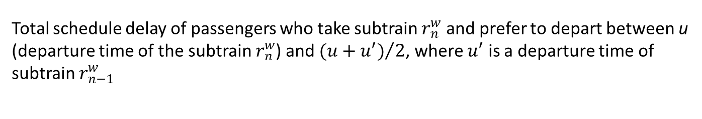
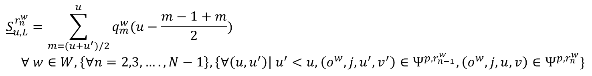
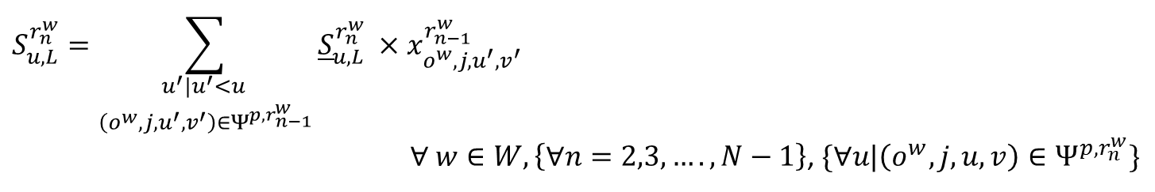
Passenger train scheduling
Objective function
Schedule delay calculation for an intermediate subtrain
$${\underline{S}}_{u,L}^{r_{n}^{w}}=\sum_{m=(u+u^{′})/2}^{u}{q_{m}^{w}(u−\frac{m−1+m}{2}})$$
$$∀ w∈W, \left\{∀n=2,3,…., N−1\right\}, \left\{∀\left(u,u^{′}\right)\right| u^{′}<u, \left(o^{w},j,u^{′},v^{′}\right)∈Ψ^{p,r_{n−1}^{w}}, \left(o^{w},j,u,v\right)∈Ψ^{p,r_{n}^{w}}\}$$
$$S_{u,L}^{r_{n}^{w}}=\sum_{\begin{aligned}u^{′}|u^{′}<u \\ \left(o^{w},j,u^{′},v^{′}\right)∈Ψ^{p,r_{n−1}^{w}}\end{aligned}}{{\underline{S}}_{u,L}^{r_{n}^{w}} ×x_{o^{w},j,u^{′},v^{′}}^{r_{n−1}^{w}}}$$
$∀ w∈W, \left\{∀n=2,3,…., N−1\right\}$, $\{∀u|\left(o^{w},j,u,v\right)∈Ψ^{p,r_{n}^{w}}\}$
Total schedule delay of passengers who take subtrain $r_{n}^{w}$ and prefer to depart between u (departure time of the subtrain $r_{n}^{w}$) and ${(u+u^{′})}/2$, where $u^{′}$ is a departure time of subtrain $r_{n−1}^{w}$
Total schedule delay of passengers who prefer to depart before $u$ (departure time of subtrain $r_{n}^{w}$) and end up boarding subtrain $r_{n}^{w}$

Slide 55
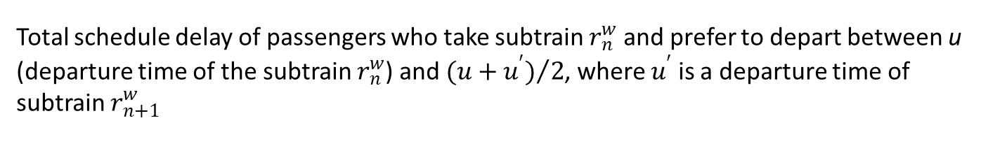
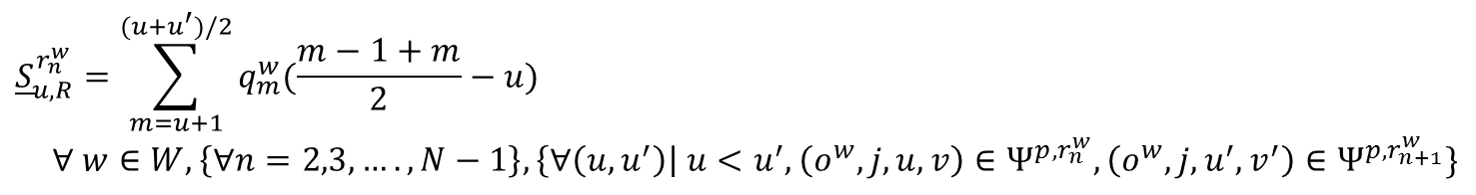
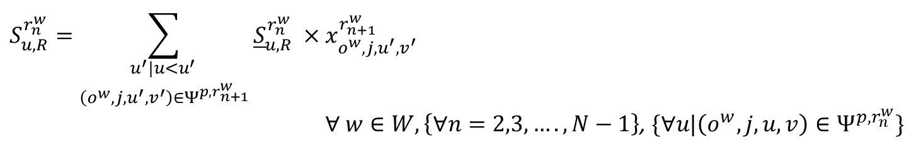
Passenger train scheduling
Objective function
Schedule delay calculation for an intermediate subtrain (Cont’d)
$${\underline{S}}_{u,R}^{r_{n}^{w}}=\sum_{m=u+1}^{(u+u^{′})/2}{q_{m}^{w}(\frac{m−1+m}{2}}−u)$$
$$∀ w∈W, \left\{∀n=2,3,…., N−1\right\}, \left\{∀\left(u,u^{′}\right)\right| u<u^{′},\left(o^{w},j,u,v\right)∈Ψ^{p,r_{n}^{w}}, \left(o^{w},j,u^{′},v^{′}\right)∈Ψ^{p,r_{n+1}^{w}}\}$$
$$S_{u,R}^{r_{n}^{w}}=\sum_{\begin{aligned}u^{′}|u<u^{′} \\ \left(o^{w},j,u^{′},v^{′}\right)∈Ψ^{p,r_{n+1}^{w}}\end{aligned}}{{\underline{S}}_{u,R}^{r_{n}^{w}} ×x_{o^{w},j,u^{′},v^{′}}^{r_{n+1}^{w}}}$$
$∀ w∈W, \left\{∀n=2,3,…., N−1\right\}$, $\{∀u|\left(o^{w},j,u,v\right)∈Ψ^{p,r_{n}^{w}}\}$
Total schedule delay of passengers who take subtrain $r_{n}^{w}$ and prefer to depart between u (departure time of the subtrain $r_{n}^{w}$) and ${(u+u^{′})}/2$, where $u^{′}$ is a departure time of subtrain $r_{n+1}^{w}$
Total schedule delay of passengers who prefer to depart a$fter u$ (departure time of subtrain $r_{n}^{w}$) and end up boarding subtrain $r_{n}^{w}$

Slide 56
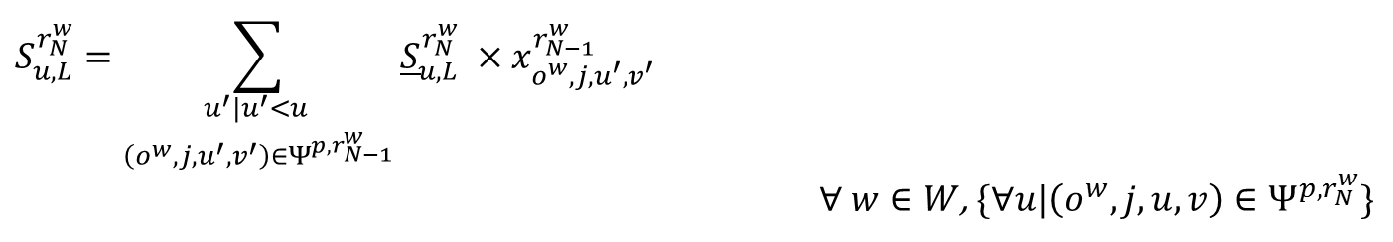
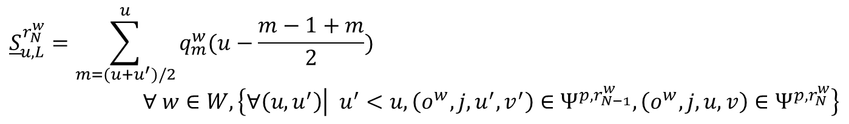
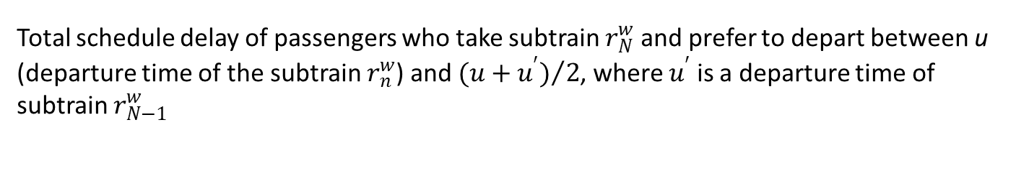
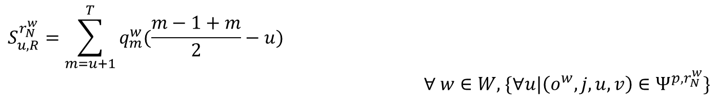
Passenger train scheduling
Objective function
Schedule delay calculation for the last subtrain
$${\underline{S}}_{u,L}^{r_{N}^{w}}=\sum_{m=(u+u^{′})/2}^{u}{q_{m}^{w}(u−\frac{m−1+m}{2}})$$
$$∀ w∈W, \left\{∀\left(u,u^{′}\right) | u^{′}<u,\left(o^{w},j,u^{′},v^{′}\right)∈Ψ^{p,r_{N−1}^{w}}, \left(o^{w},j,u,v\right)∈Ψ^{p,r_{N}^{w}}\right\}$$
$$S_{u,L}^{r_{N}^{w}}=\sum_{\begin{aligned}u^{′}|u^{′}<u \\ \left(o^{w},j,u^{′},v^{′}\right)∈Ψ^{p,r_{N−1}^{w}}\end{aligned}}{{\underline{S}}_{u,L}^{r_{N}^{w}} ×x_{o^{w},j,u^{′},v^{′}}^{r_{N−1}^{w}}}$$
$∀ w∈W$, $\{∀u|\left(o^{w},j,u,v\right)∈Ψ^{p,r_{N}^{w}}\}$
Total schedule delay of passengers who take subtrain $r_{N}^{w}$ and prefer to depart between u (departure time of the subtrain $r_{n}^{w}$) and ${(u+u^{′})}/2$, where $u^{′}$ is a departure time of subtrain $r_{N−1}^{w}$
Total schedule delay of passengers who prefer to depart between$u$ (departure time of subtrain $r_{N}^{w}$) and t=T and end up boarding subtrain $r_{N}^{w}$
Total schedule delay of passengers who prefer to depart before $u$ (departure time of subtrain $r_{N}^{w}$) and end up boarding subtrain $r_{n}^{w}$
$$S_{u,R}^{r_{N}^{w}}=\sum_{m=u+1}^{T}{q_{m}^{w}(\frac{m−1+m}{2}−u})$$
$∀ w∈W,$ $\{∀u|\left(o^{w},j,u,v\right)∈Ψ^{p,r_{N}^{w}}\}$

Slide 57
Impact of delay tolerance level
Setup:
  The less stringent nature of freight train planning is characterized by specifying an earliest departure time and a maximum delay allowance time for each train
  A multiplier of unimpeded trip time is used to bound the maximum en-route delays (i.e., delay tolerance)
  The multipliers varies from 0.1 and 0.6 with 0.1 increments
  Passenger train speed: 120 mph
  Freight train speed: 60 mph

Slide 58
Impact of delay tolerance level
Freight foregone demand cost
Greater tolerance of delays reduces foregone demand cost
Increasing passenger train services generally increases foregone demand cost across all delay tolerance levels

Slide 59
Impact of delay tolerance level
Freight delay costs
Delay costs become larger as we progressively relax the delay tolerance level
Lowering the delay tolerance level results in a fewer number of freight trains enabling trains to depart their origin with lower delays

